Slide 1


Introduction to Internet of Things (IoT Hardware and Simulation)
Instructor:
Reza Serati

Slide 2
Prospects
Introduction to Microcontrollers
Introducing NodeMCU ESP8266
Arduino environment
Sensors
Simulation environment

Slide 3
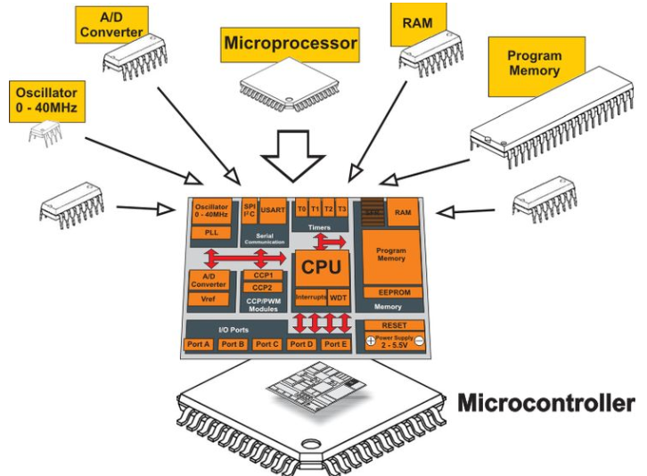
Introduction to Microcontrollers (Microprocessor VS Microcontroller)

Slide 4
Introduction to Microcontrollers (Microprocessor VS Microcontroller)
Microcontrollers are designed to perform specific tasks
Depending on the input, some processing needs to be done and output is delivered
they need small resources like RAM, ROM, I/O ports, etc. and hence can be embedded on a single chip
Microprocessors find in applications where tasks are unspecific
relationship between input and output is not defined
They need high amount of resources like RAM, ROM, I/O ports etc.
A microprocessor cannot be used stand alone. They need other peripherals like RAM, ROM, buffer, I/O ports etc. and hence a system designed around a microprocessor is quite costly.
Basically, you can make and design whatever you want on the available resources of the Microprocessors whereas, in order to do the same, you have to extend to the peripherals on a microcontroller.

Slide 5
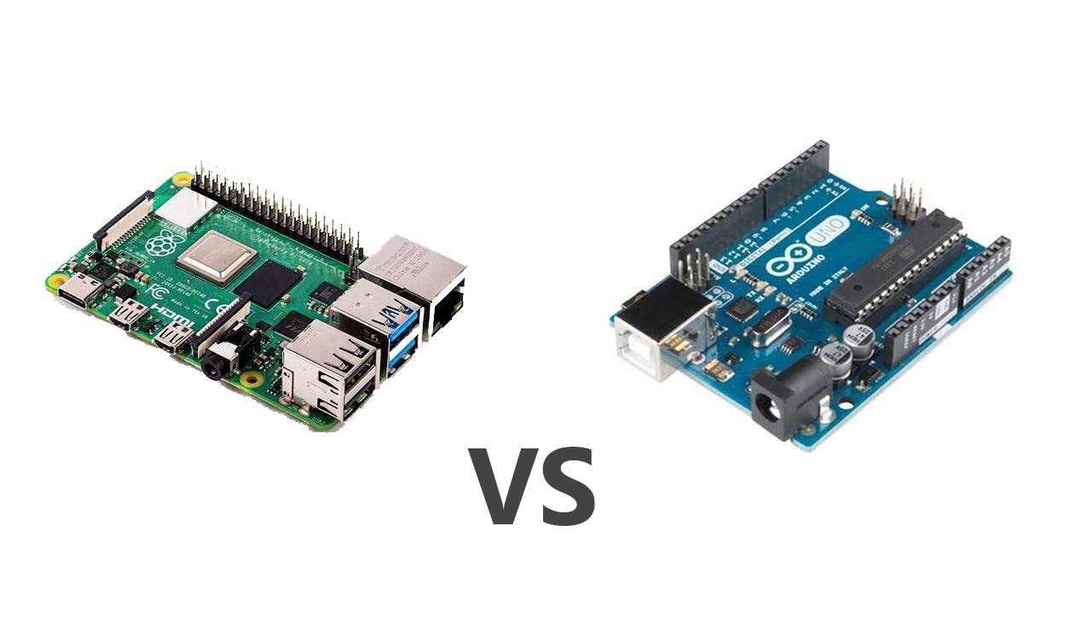
Introduction to Microcontrollers (Microprocessor VS Microcontroller)

Slide 6
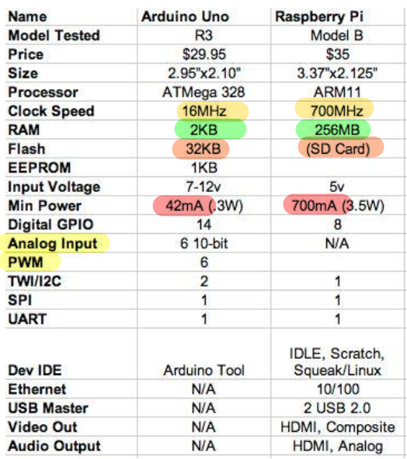
Introduction to Microcontrollers (Microprocessor VS Microcontroller)

Slide 7
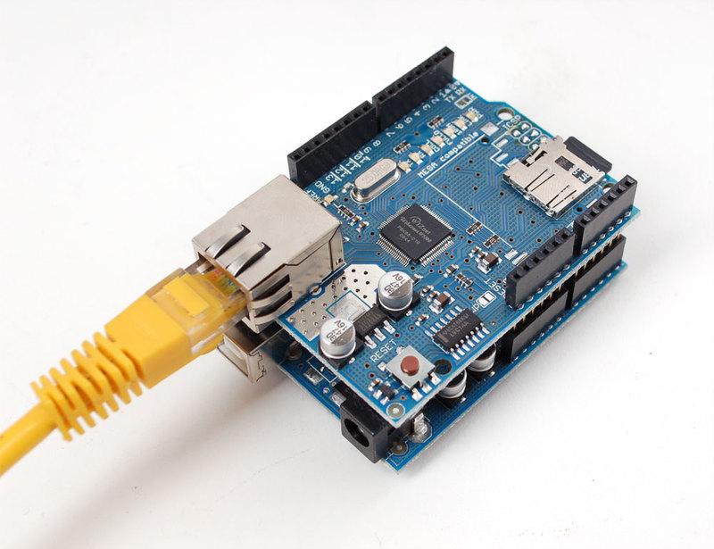
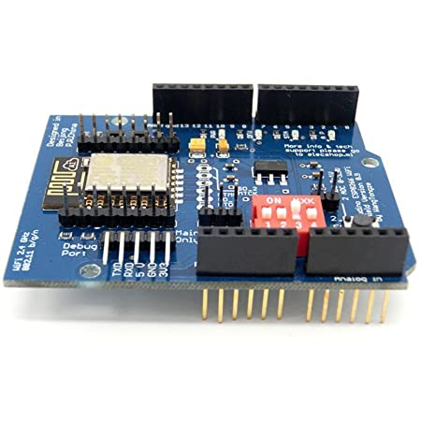
Introduction to Microcontrollers (Microprocessor VS Microcontroller)

Slide 8
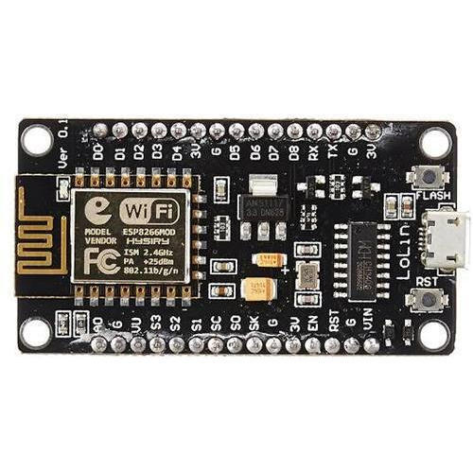
Introducing NodeMCU ESP8266

Slide 9
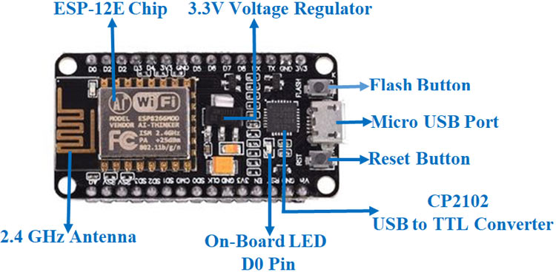
Introducing NodeMCU ESP8266

Slide 10
Introducing NodeMCU ESP8266
The ESP8266 NodeMCU has total 17 GPIO pins broken out to the pin headers on both sides of the development board. These pins can be assigned to all sorts of peripheral duties, including:
ADC channel – A 10-bit ADC channel.
UART interface – UART interface is used to load code serially.
PWM outputs – PWM pins for dimming LEDs or controlling motors.
SPI, I2C & I2S interface – SPI and I2C interface to hook up all sorts of sensors and peripherals.

Slide 11
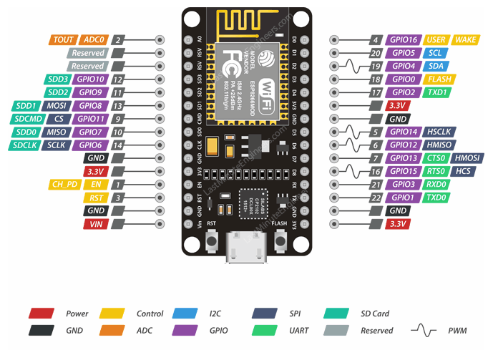
Introducing NodeMCU ESP8266

Slide 12
Introducing NodeMCU ESP8266

Slide 13
Arduino environment

Slide 14
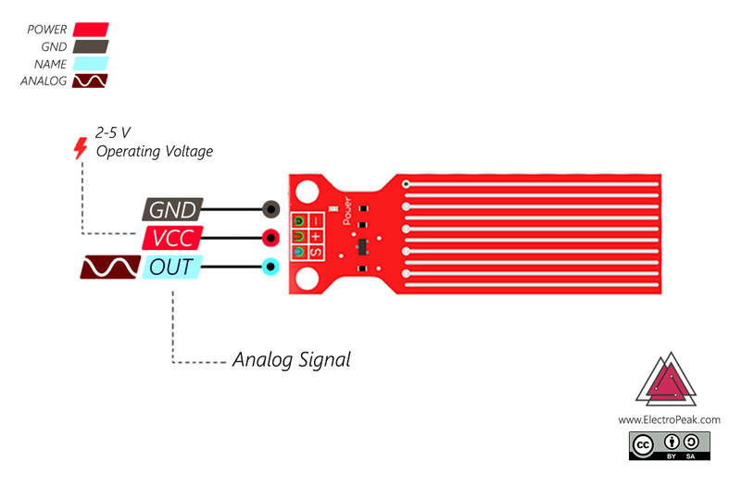
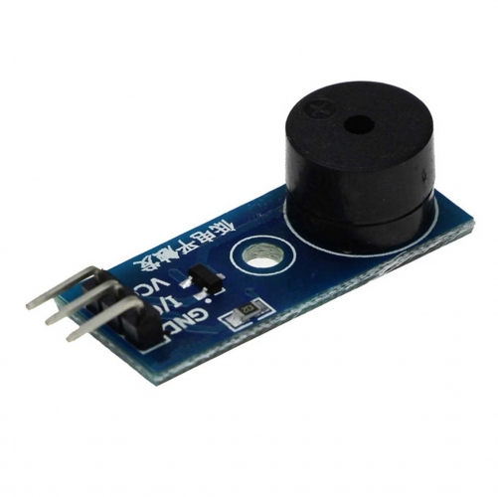
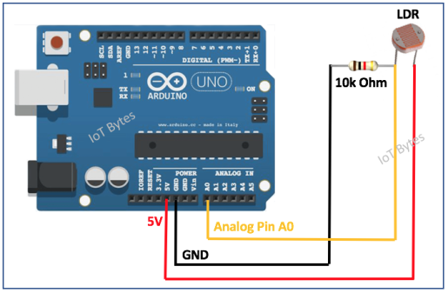
Sensors
LDR

Slide 15
Sensors
LDR
Buzzer

Slide 16
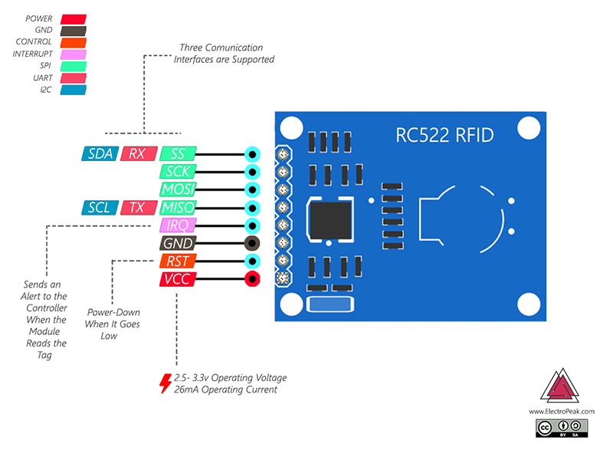
Sensors
LDR
Buzzer
RFID

Slide 17
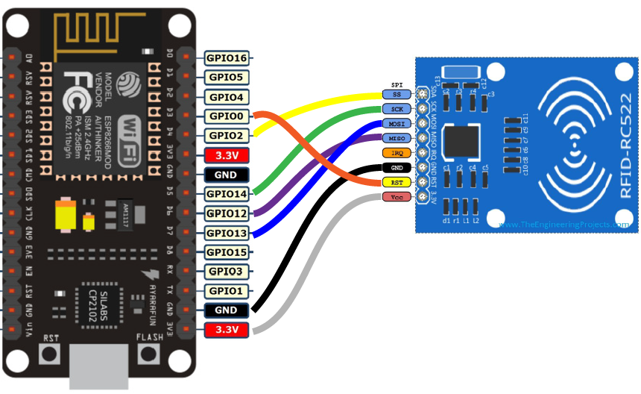
Sensors
LDR
Buzzer
RFID

Slide 18
Sensors
LDR
Buzzer
Water level indicator
RFID

Slide 19
Simulation environment

